Slide 1
Cryptographic Attacks
Attackers:
Colin Rice
Sam Milito
Jacob Shedd
Defenders:
Jason Parham
Matt O'Brian
Tyler Cassetta-Frey

Slide 2
Protocol Summary
RSA for asymmetrical communication
AES for symmetrical communication
Nonce on ATM/bank
SHA512 for hashing
Random padding

Slide 3
Protocol Summary (cont)
Resistant to replay attacks
Resistant to most traffic analysis
Protection against brute-forcing PINs
Session timeouts for users

Slide 4
Minor Flaws & Exploit Vectors
Poor Scaling
Key Management
Poor PIN Verification
pin = getPin("PIN: ");
pin = pin.substr(0,6);
while(pin.length() < 6)
{
pin = pin + "0";
}
pin = toNumbers(pin);

Slide 5
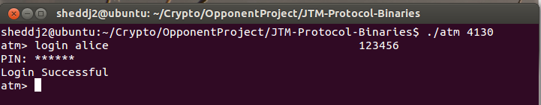
Minor Flaws & Exploit Vectors (cont)
Single Line Commands

Slide 6
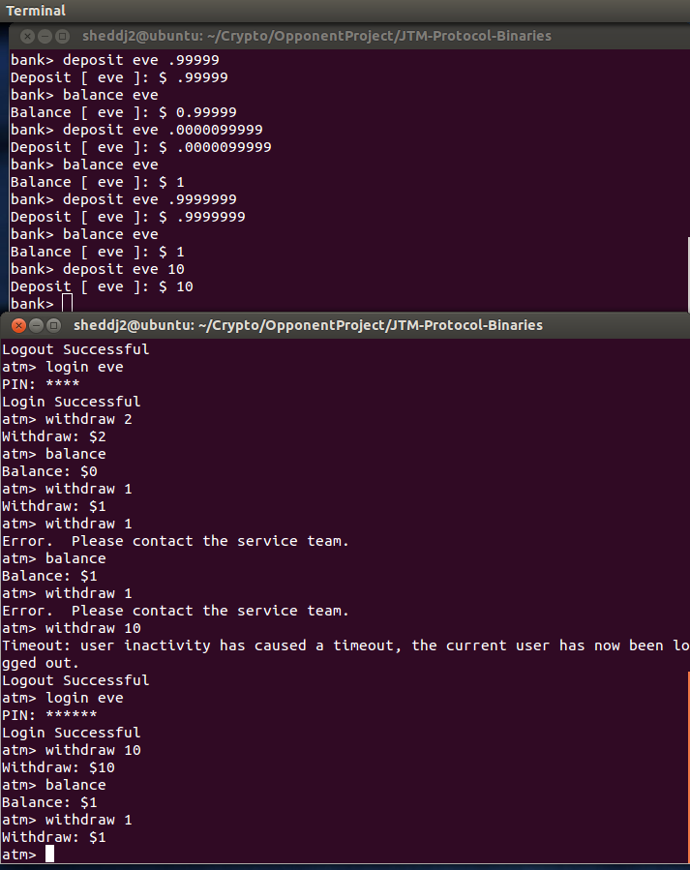
Minor Flaws & Exploit Vectors (cont)
No Server-Side
Input Verification

Slide 7
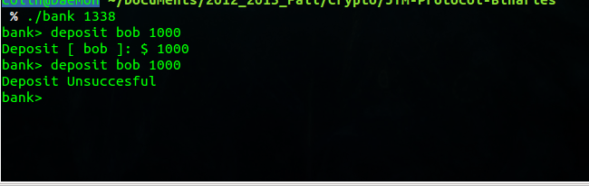
Minor Flaws & Exploit Vectors (cont)
Arbitrary Deposit Limit on Bank

Slide 8
Critical Flaws & Exploits (Cont)
Unhashed/Used Card Contents [Demo]
if(it->get_un() == info.at(1) && it->get_pin() == pin && !it->get_logged_in() && !it->get_locked()) {
it->set_logged_in_true ();
return true;
}
std::string getCardHash(std::string cardFile)
{
std::ifstream card(cardFile.c_str());
std::string tempHash((std::istreambuf_iterator<char>(card)),std::istreambuf_iterator<char>());
std::string cardHash = tempHash;
cardHash = cardHash.substr(0,128);
std::transform(cardHash.begin(), cardHash.end(), cardHash.begin(), ::toupper);
cardHash = toHex(cardHash);
return cardHash;
}

Slide 9
Critical Flaws & Exploits (Cont)
Unhashed/Used Card Contents (cont)
  Login attempts get locked out correctly
  Via transfer exploits and card dysfunction, attempted logins are easy
  Any account can be locked out by anyone

Slide 10
Critical Flaws & Exploits (Cont)
No HMAC
Plaintext Login Info
void* formATMPacket(char packet[], std::string command, std::string username, std::string cardHash, std::string pin, std::string item1, std::string item2, std::string atmNonce, std::string bankNonce)
{
std::vector<std::string> tempVector;
tempVector.push_back(command);
tempVector.push_back(username);
tempVector.push_back(cardHash);
tempVector.push_back(pin);
tempVector.push_back(item1);
tempVector.push_back(item2);
tempVector.push_back(atmNonce);
tempVector.push_back(bankNonce);
formPacket(packet, 1023, tempVector);
}

Slide 11
Critical Flaws & Exploits (Cont)
RNG issues
std::string getRandom(int length)
{
std::string retStr = "";
CryptoPP::AutoSeededRandomPool rng;
int random;
int num = 0;
bool hex = true;
for(unsigned int i = 0; i < length; ++i)
{
random = (int) rng.GenerateByte();
if(hex)
{
// Generate Random Hex String
num = (int) (random % 16);
if(num < 10)
{
retStr += (num + '0');
}
else
{
retStr += ((num - 10) + 'A');
}
}
else
{
// Generate Random String With ASCII Range (48, 126)
num = (int) (random % (126 - 48));
retStr += (num + '0');
}
}
return retStr;
}

Slide 12
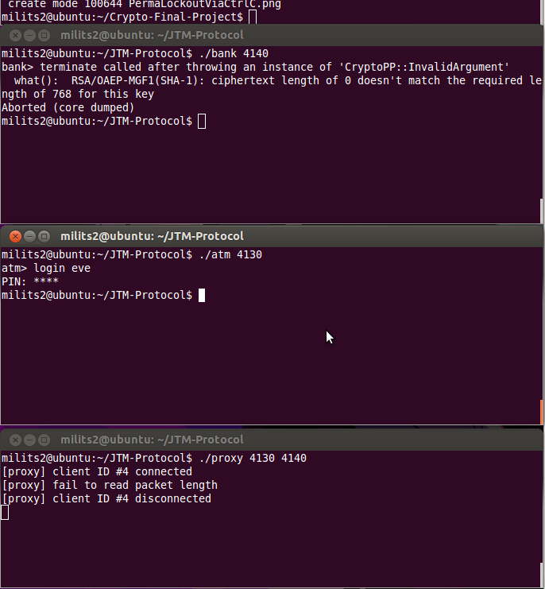
Critical Flaws & Exploits (Cont)
Crash Bank/ATM
strcpy( packet, "" );

Slide 13
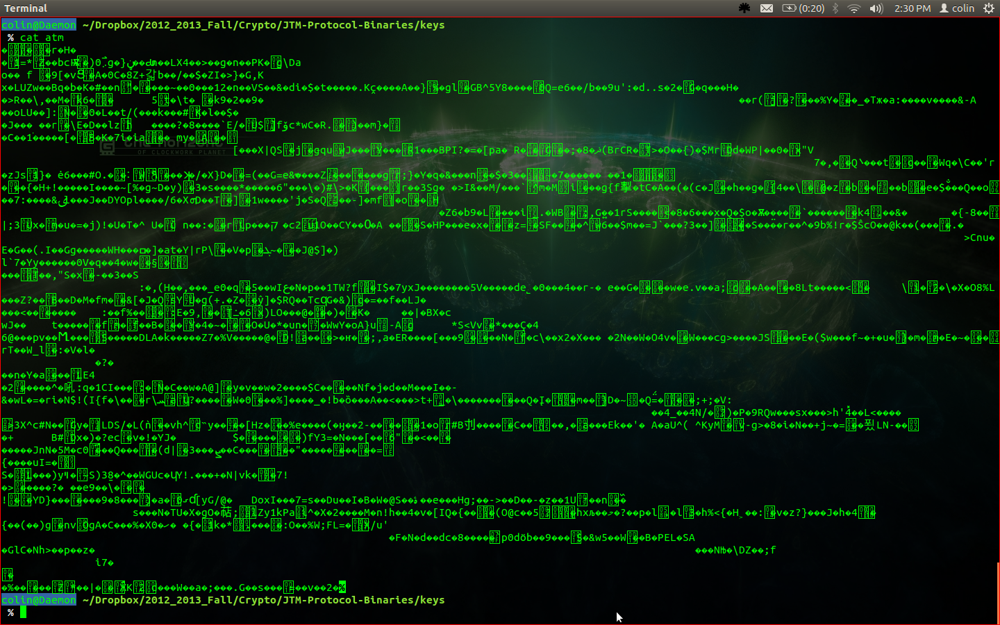
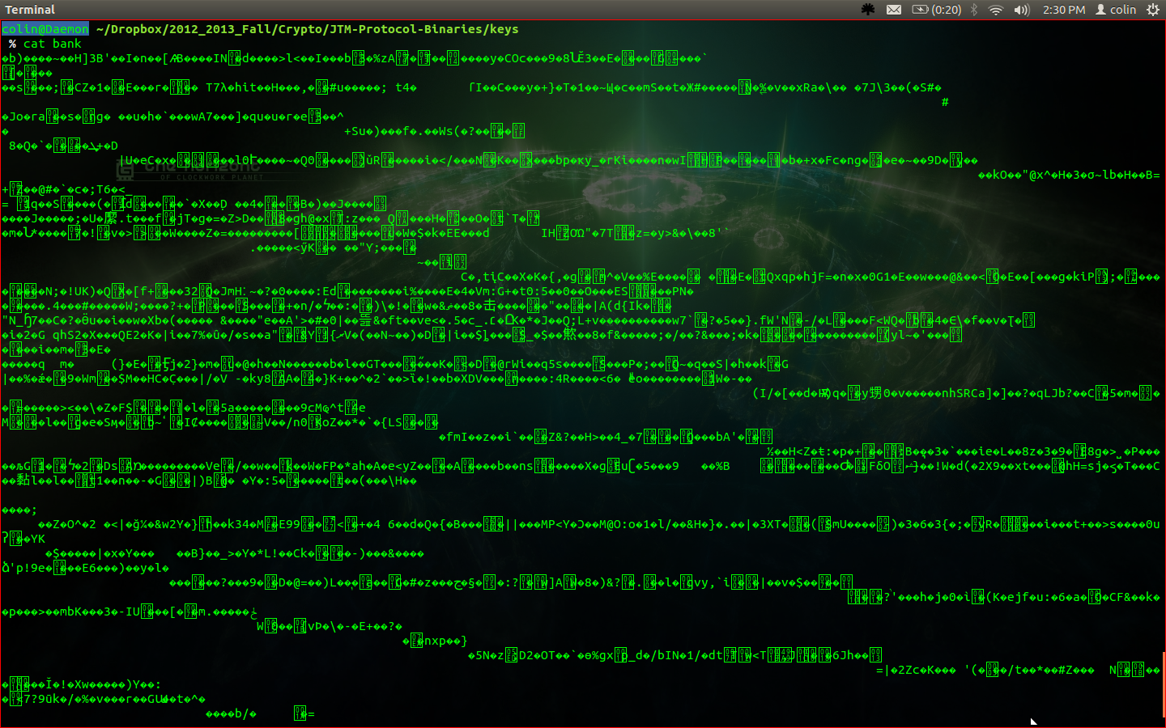
Critical Flaws & Exploits (Cont)
Keys Not Hardcoded

Slide 14
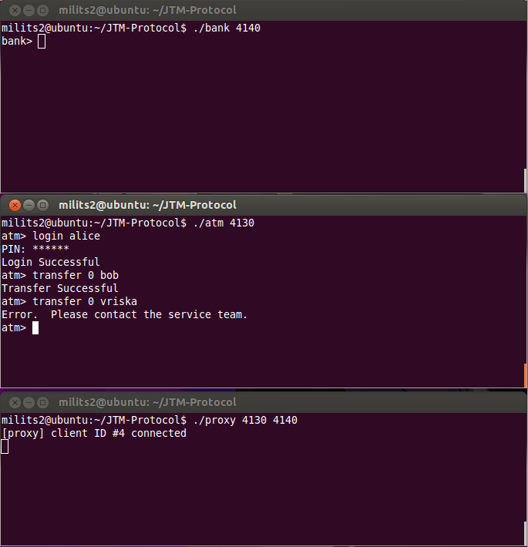
Critical Flaws & Exploits (Cont)
Account Enumeration

Slide 15
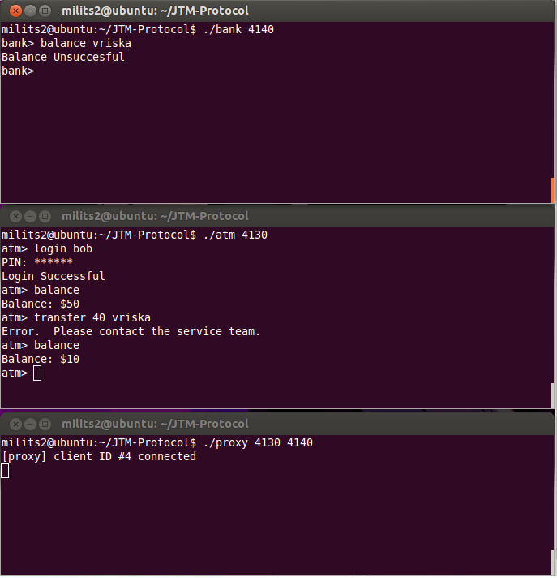
Critical Flaws & Exploits (Cont)
Invalid Transfers Withdraw Money
it->reduce_balance(b);
it->increase_transfer (b);

Slide 16
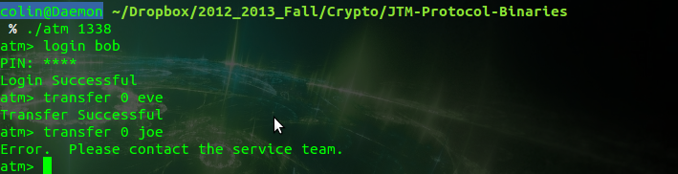
Critical Flaws & Exploits (Cont)
Account Enumeration Via Transfer

Slide 17
Critical Flaws & Exploits (Cont)
Race Conditions [Demo]
Demonstration

Slide 18
Critical Flaws & Exploits (Cont)
Handshake Hijack [Demo]
Embedded RNG Issues
No Signing Anywhere
Demonstration

Slide 19
Final Remarks
Main issues
  Crashing bank
  Account info exposure/lack of use
  Ability to masquerade as bank
Questions?

